Slide 1
HPC and computing resources @ UA

Slide 2
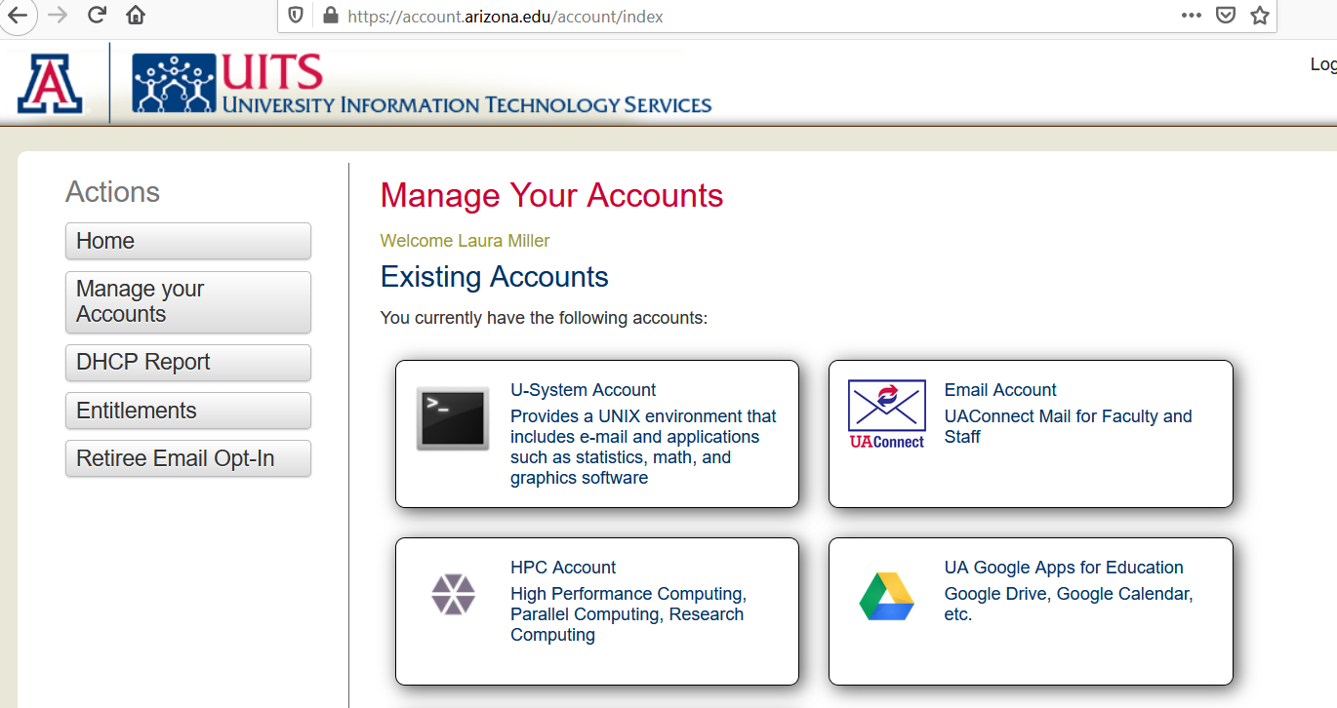
Services available
UA offers a variety of services, including a Unix environment and an HPC account. https://account.arizona.edu

Slide 3
U-System - Unix environment
Create an Account
Go to Accounts Management. - a NetID is required
Select U-System Account. The account will be created for you without any further input.
Refresh the Accounts Management page to verify that the U-System Account icon now appears under Existing Accounts rather than Available Accounts.

Slide 4
Vpn - often needed to log into UA remotely
Start a vpn session
Use the Cisco client
The server is vpn.arizona.edu
Logging in requires 2-step authentication. For the second password, type push (push notification) or phone (phone notification).
More information is here: UA Virtual Private Network (VPN) | Information Technology | University of Arizona

Slide 5
Get on to the U-System
How to Connect
Download a free *SSH client from the Software License website.
Run the SSH client.
Enter Host Name netid@u.arizona.edu.
Enter Port Number: 22.
Select either SFTP or SSH (depending on which is available).
Enter your NetID username for Username.
Enter your NetID password for Password.
Try to connect.
Once connected, you may want to visit the list of available software.

Slide 6

Run a simple python program
Let’s create a simple python program. To do this, we will use the nano editor. In the terminal, type nano hello.py
The editor should open. Type print(‘hello world’)
Now click Ctrl+X to exit, and type Y for yes to save.
To run the program, type python hello.py.

Slide 7
Moving files
Type ls and you will see the list of files and folders on your U-system account.
To remove hello.py, type rm hello.py. There should also be a public_html folder.
To run programs and download results, you will need to move files back and forth from your computer to the remote U-system computer.
.

Slide 8
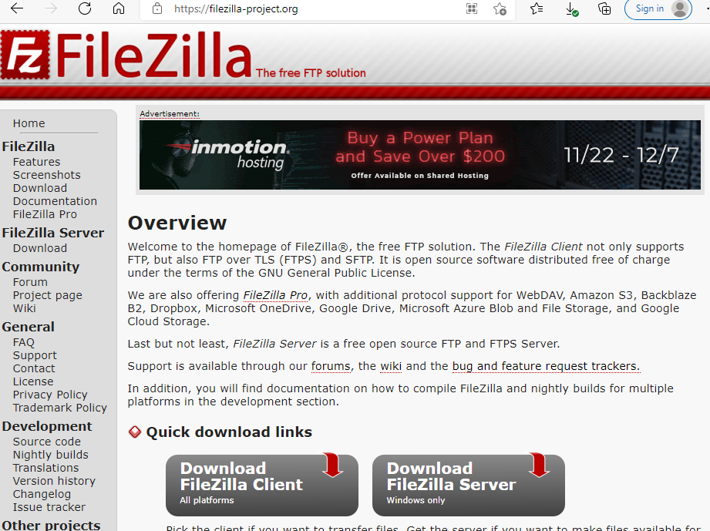
Filezilla - Download and upload files with GUI on U-System
FileZilla - The free FTP solution (filezilla-project.org)

Slide 9
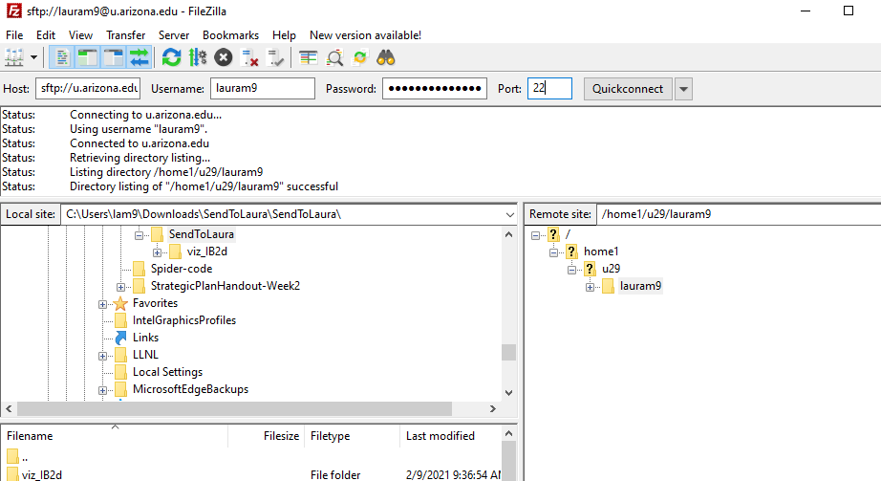

Slide 10
Using sftp
Open a terminal. You may want to cd to the directory where files you want to upload/download live. For example, cd Desktop if it’s on your Desktop. Otherwise, you need to know the path so that you can use that when you upload/download. For example cd C:/Users/lam9/Desktop
Enter Host Name netid@u.arizona.edu.
Enter Port Number: 22.
Select either SFTP or SSH (depending on which is available).
Alternatively, in a terminal type sftp netid@uarizona.edu

Slide 11
Transferring files and folders
Now you have logged into U-System. Type ls and you will see the files in your current U-system directory. Type pwd to see the current path. You may also cd to while you would like to upload or download files.
To upload a file from your computer to U-System, type put file. To put an entire folder on U-System, type put -r folder
If you want to get files / folders from U-System to your computer, cd to where the folder lives and type get file or get -r folder
More information on how to transfer files is here. https://public.confluence.arizona.edu/display/UAHPC/Transferring+Files

Slide 12
U-System Software
A number of software packages are available through U-System. To see a list, please visit:
https://it.arizona.edu/documentation/u-system-software

Slide 13
Virtual Desktops
You can set up your virtual desktop here:
https://arizona.apporto.com/
You can also access it here:
vcat.arizona.edu

Slide 14
VCAT
Pros: No need to download and install lots of software like ANSYS
Cons: Sometimes lots of people are using it and it is SLOW
List of available software:
Adobe Acrobat Pro, Adobe Animate, Adobe Audition, Adobe Dreamweaver, Adobe Illustrator, Adobe InDesign, Adobe Lightroom, Adobe Photoshop, Anaconda 3, Ansys 2022 R1, ArcGIS Pro 2.9, ArcMap 10.8, AutoCAD 2020, Autodesk Maya 2022, Autodesk Revit 2020, Blender 3, Carbide Create, ChemDraw 19.0, Eagle CAD 9.6, Enterprise Architect, Microsoft Excel, Geneious Prime, Jupiter Notebook, Maple 2019, Matlab R2021a, Mendeley Desktop, MeshLab, Meshmixer, MetaShape Pro, Minitab 19, Microsoft Office 2019 Professional, Neurons in Action, PSpice Lite, Rhino 6, RStudio, Sketchup 2022, Solidworks 2019, SPSS Statistics Premium 28, Spyder, StataSE 16, Visual MINTEQ 3.1, VLC Media Player, VS Code, WinSCP, Zotero

Slide 15
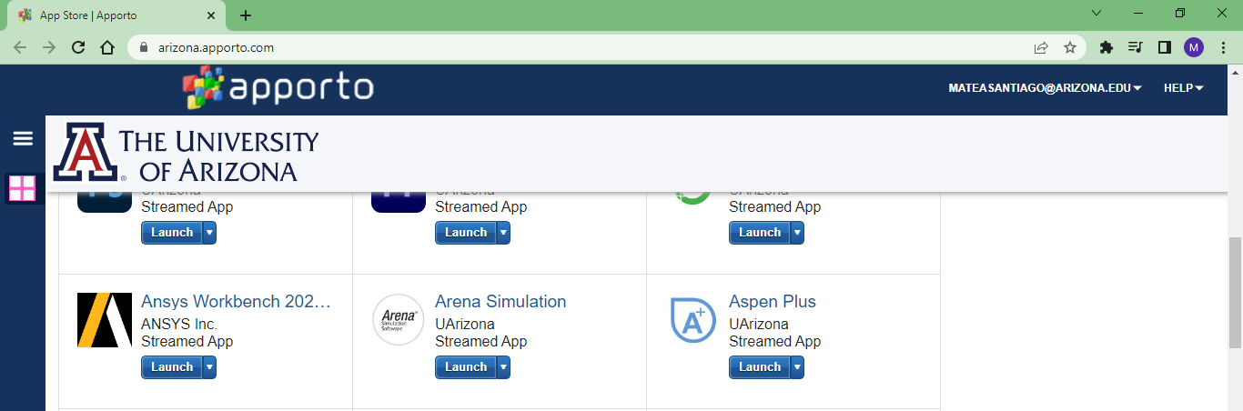
Launch Ansys Workbench
A new tab will pop up with ANSYS – It takes a few minutes

Slide 16
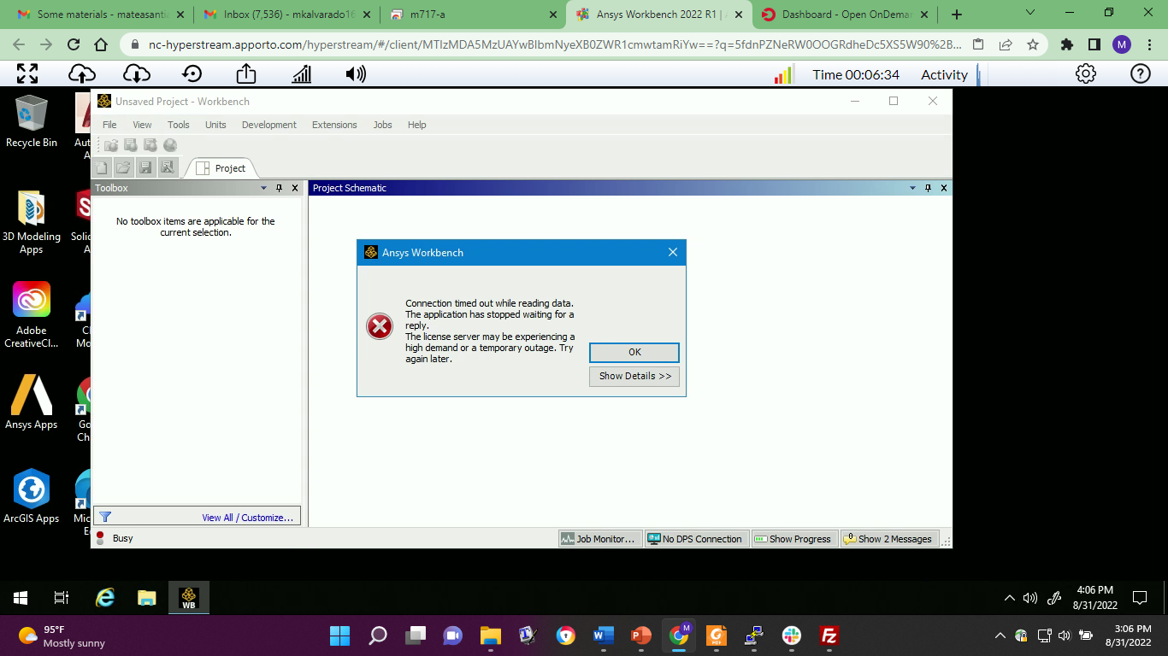

Slide 17
Request the High Performance Computing Service
You must have an HPC account to use the Research Data Center services.
Log in at https://account.arizona.edu, go to Manage your Accounts, and choose High Performance Computing.
Your PI will need to add you to their group.
You can find more information about getting started at HPC Documentation.
Note that there is a charge for simulations – please use the windfall partition unless you have permission for standard.

Slide 18
HPC at UA
You can use Jupyter notebooks, MATLAB, and other software through a web interface using Puma and ElGato.
To log into the web interface, go to https://OnDemand.hpc.arizona.edu

Slide 19
Vpn - often needed to log into UA remotely
Start a vpn session
Use the Cisco client
The server is vpn.arizona.edu
Logging in requires 2-step authentication. For the second password, type push (push notification) or phone (phone notification).
More information is here: UA Virtual Private Network (VPN) | Information Technology | University of Arizona

Slide 20
Moving files through the terminal - Using sftp
Open a terminal that allows 2-step authentication (Cygwin for PC, terminal for Mac).
You may want to cd to the directory where files you want to upload/download live. For example, cd Desktop if the files are on your Desktop. Otherwise, you need to know the path so that you can use that when you upload/download. For example C:/Users/lam9/Desktop
Enter Host Name netid@filexfer.hpc.arizona.edu.
Enter Port Number: 22.
Select SFTP.
Alternatively, in a terminal type sftp netid@filexfer.hpc.arizona.edu

Slide 21
Terminal - transferring files and folders
Once logged in, type puma or ocelot to use one of these servers.
Type ls and you will see the files in your current directory. Type pwd to see the current path. You may also cd to while you would like to upload or download files.
To upload a file from your computer to the cluster, type put file. To put an entire folder on the cluster, type put -r folder
If you want to get files / folders from the cluster to your computer, cd to where the folder lives and type get file or get -r folder

Slide 22
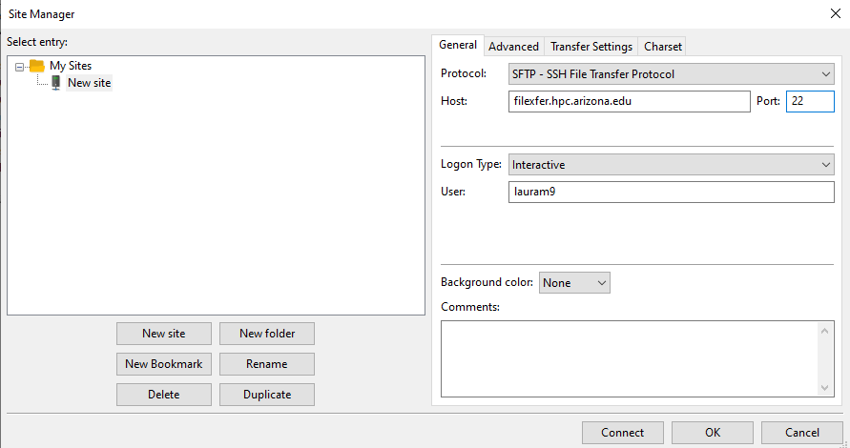
Moving files with Filezilla
In FileZilla, select the File menu
Select Site Manager
Select an existing site or select New Site to create a new connection
Enter the following information in the General tab:
Protocol: SFTP
Host: enter the server name
filexfer.hpc.arizona.edu
Logon Type: Interactive
User: Your NetID

Slide 23
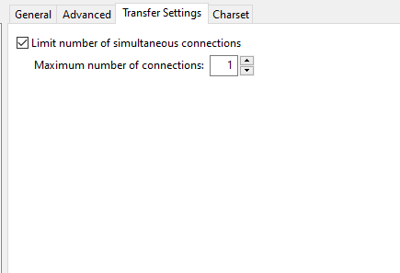
Moving files with Filezilla
Select the Transfer Settings tab
Select "Limit number of simultaneous connections"
Set simultaneous connections to: 1
Click Connect
In the first password box, enter your NetID password
In the second password box, type a 1 for Duo push or enter a passcode from your Duo device
You can now use FileZilla to transfer files to and from the shell server.

Slide 24
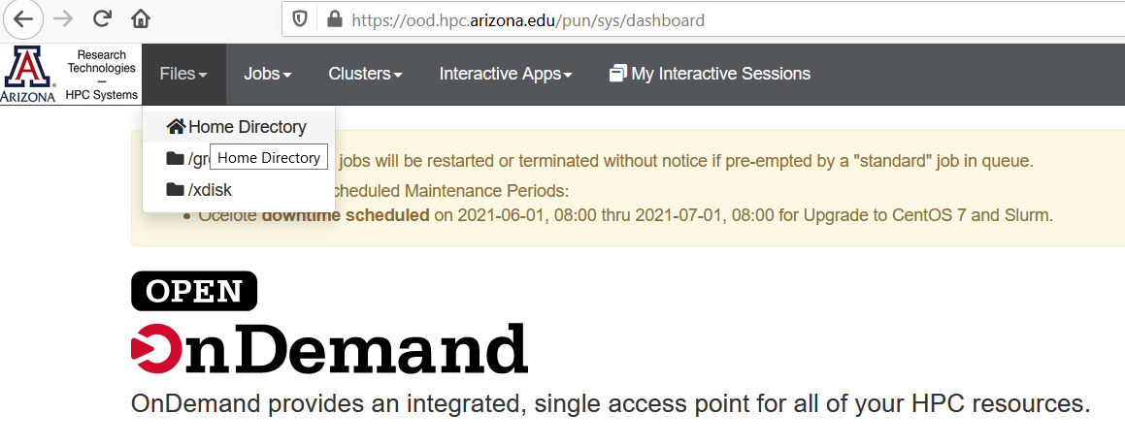
GUI - Moving files
From the OpenOnDemand portal, select files and home directory

Slide 25
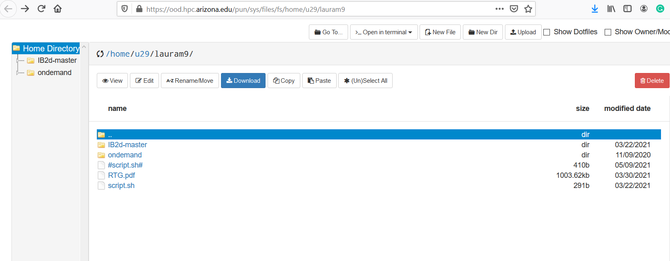
You may now upload/download through the web interface

Slide 26
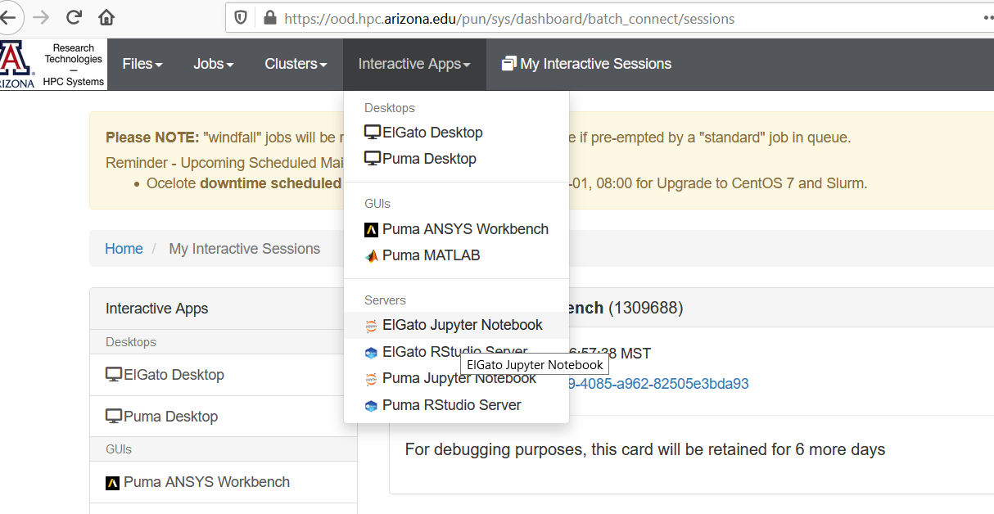
Jupyter Notebooks
Go to interactive apps and select ElGato Jupyter Notebook

Slide 27
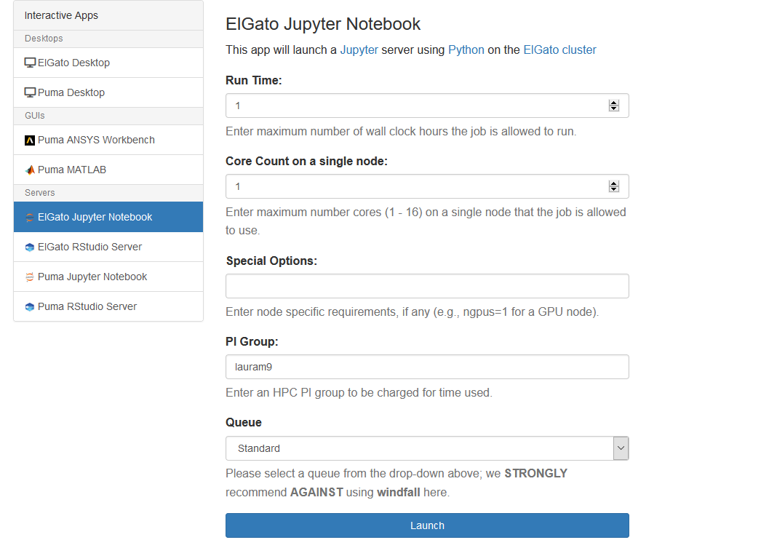
Select options
Note that if you select Standard, your PI will be charged for the time. Although windfall is not recommended, it is free and can be used for low risk tasks.
Select launch to get started.

Slide 28
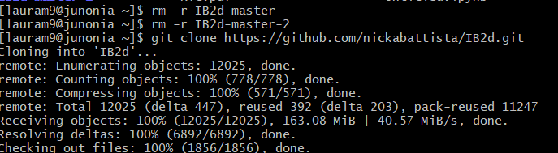
Using git on your HPC account to clone a repository
In this example, I am going to clone ib2d (a 2D version of the immersed boundary method).
To clone ib2d onto your account
Type git clone https://github.com/nickabattista/IB2d.git
To update ib2d
Cd into the ib2d folder
Type git pull origin master
Tutorials on git from the command line
https://git-scm.com/docs/gittutorial
Screenshot where I removed my old versions of ib2d and used git clone:

Slide 29
Available Resources
Puma
Puma Quick Start - UA HPC - Confluence (arizona.edu)
Uses SLURM scheduling software
Ocelot
Uses SLURM scheduling software
ElGato
After you login to the bastion host, select puma or ocelot
Once connected, you are using a login node.
It is important to know that the login nodes are not the location where scripts are run. Heavy computation on the login nodes slows the system down for all users
software is not available on the login nodes

Slide 30
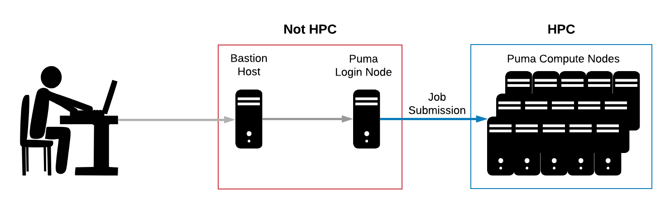
Scheduler
Users may run their work on HPC by submitting a job request to a scheduler. A scheduler, in this case SLURM, is software that will reserve resources and run work on the cluster's compute nodes when space becomes available. To do this, you will need to write a script that requests compute resources and gives the system a blueprint of how to run your work.

Slide 31
Accessing software
Now, let's get down to the nitty-gritty of creating and submitting a job. First, let's talk about what software is available on the system, where it is, and how to use it.
As mentioned a few sections ago, software is not available on the login nodes. To see and use software, you must request an interactive session. This sends a request to the scheduler to take you from the login node to a compute node. An alias is set up on Puma to do this quickly and easily. Enter interactive on the command line to request a single core interactive session for one hour, e.g.:
[netid@wentletrap ~]$ interactive
srun: job 57384 queued and waiting for resources
srun: job 57384 has been allocated resources
[netid@r1u03n2 ~]$

Slide 32
Modules
The change in the command line prompt shows you are now on a compute node. From there, you may view and access individual software packages which are made available as modules. Modules allow for the customization of your environment, including allowing access to different versions of the same software. Take a look at what’s installed by running the command module avail
To use a particular module, type module load <software>.
If you ever want to see the modules you currently have loaded, use the command module list. To unload a piece of software, use the command module unload <software>.

Slide 33
Writing a SLURM Submission Script
To submit your work for execution with SLURM, you must write a script to tell it how to run your job. These scripts are partitioned into two sections:
Resource Requests
The first portion of your script tells the system the resources you’d like to reserve. This includes the number of nodes/cores you need, the time it will take to run your job, the memory required, your group's name, the partition, and any special instructions (e.g. requesting gpus if applicable).
Other optional job specifications may also be set such as a job name or requesting email notifications. Each line with one of these requests will start with #SBATCH. If you’d like to comment out optional specifications that you don’t want, change these to ### SBATCH. You may also delete them.
Job Instructions
The second section tells the system exactly how to do your work. These are all the commands (e.g. loading modules, changing directories, etc) that you would execute in your current environment to run your script successfully.

Slide 34
SLURM submission script
#!/bin/bash
# --------------------------------------------------------------
### PART 1: Requests resources to run your job.
# --------------------------------------------------------------
### Optional. Set the job name
#SBATCH --job-name=hello_world
### Optional. Set the output filename.
### SLURM reads %x as the job name and %j as the job ID
#SBATCH --output=%x-%j.out
### REQUIRED. Specify the PI group for this job
#SBATCH --account=<PI GROUP>
### Optional. Request email when job begins and ends
### SBATCH --mail-type=ALL
### Optional. Specify email address to use for notification
### SBATCH --mail-user=<YOUR NETID>@email.arizona.edu
### REQUIRED. Set the partition for your job.
#SBATCH --partition=standard
### REQUIRED. Set the number of cores that will be used for this job.
#SBATCH --ntasks=1
### REQUIRED. Set the number of nodes
#SBATCH --nodes=1
### REQUIRED. Set the memory required for this job.
#SBATCH --mem=1gb
### REQUIRED. Specify the time required for this job, hhh:mm:ss
#SBATCH --time=00:01:00

Slide 35
SLURM submission script continued
# --------------------------------------------------------------
### PART 2: Executes bash commands to run your job
# --------------------------------------------------------------
### Load required modules/libraries if needed
module load gnu/5.4.0
### change to your script’s directory
cd ~/hello_world
### Run your work
./hello_world
sleep 10
https://public.confluence.arizona.edu/display/UAHPC/Puma+Quick+Start#PumaQuickStart-WritingaSLURMSubmissionScript

Slide 36
Example – Using MATLAB
Look at this tutorial on how to run MATLAB through the command line
https://public.confluence.arizona.edu/display/UAHPC/Using+Matlab
We will submit the job using a script. A sample script is in this folder.
https://drive.google.com/file/d/17ocdeTnpdIf_vHHj2BlHLU4pF6Q_I5p_/view?usp=sharing
Open a terminal on your computer
Type ssh netid@hpc.arizona.edu
Type puma/ocelot to work on this cluster.
cd into the directory where the example is that you want to run
Be sure yourscript.sh is in this folder
Type sbatch yourscript.sh
To check the job, type squeue -unetid
This will show the job as pending or running. If nothing comes up, then you have no code that is running.

Slide 37
yourscript.sh
#!/bin/bash
#SBATCH --job-name=Lauras_job
#SBATCH --ntasks=1
#SBATCH --mem=16gb
#SBATCH --time=04:00:00
#SBATCH --partition=windfall
module load matlab
matlab -nodisplay -nosplash < main2d.m

Slide 38
Download data and bookkeeping
To download the results. Use the web interface or sftp, cd to where data_folder lives, and type get -r data_folder
To save space on the cluster, now remove this data. Delete in the web interface or type rm -r data_folder

